Slide 1
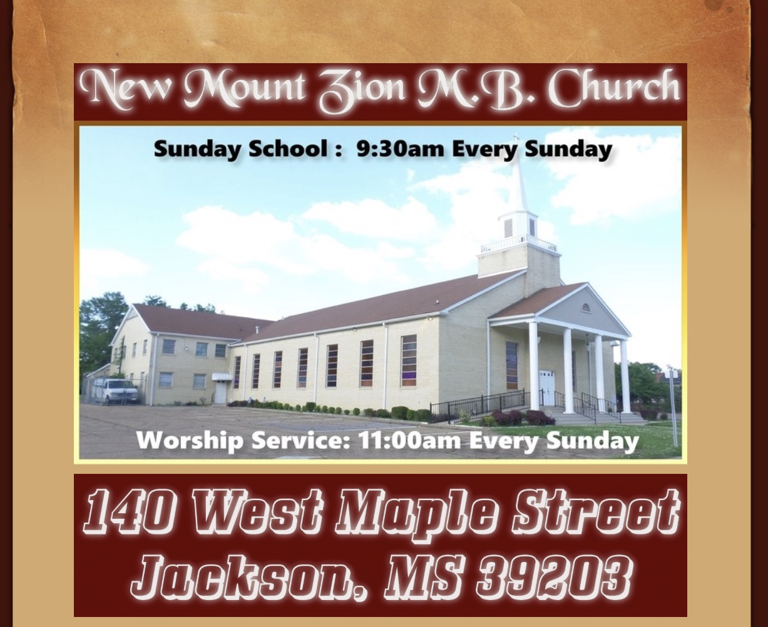
New Mount Zion M.B. Church Bible Class March 30, 2020 “Understanding The Ten Commandments” #1st Commandment

Slide 2
Why is there a need for the Ten Commandments? We all need laws to follow and go by. The 10 commandments are a code of ethics that GOD gave to man. It is evident of that because the 10 commandments can be found in the Supreme Court in Washington, DC. They are sometimes also call “Decalogue”

Slide 3
In what book and chapter are the Ten Commandments found? They are found in the book of Exodus 20 GOD gives them the laws on Mount Sinai and Deuteronomy 5 as they observe and emphasizes the law on the plains of Moab. (Deuteronomy 5: 12, 16). There are two basic divisions. Our responsibility to GOD and than our responsibility to other people.

Slide 4
To whom where they given? They are GOD’S good gift to the children of Israel, after they had been delivered from bondage in Egypt. Faithfulness of these laws was the means whereby the nation would become a kingdom of priests and a holy nation (Exodus 19: 6). But they are for all people today!

Slide 5
What special place were the commandments kept? The placement of the tablets of the Ten Commandments inside the most holy ark of the covenant indicates how special they were. The ark was made for the Ten Commandments. Storing the tablets inside the ark is symbolic to storing important documents into a safe or safety deposit box.

Slide 6
Will obeying the Ten Commandments save an individual? No they will not. Some people think just because they are obeying all of the commandments that will get them into heaven.

Slide 7
What is the first commandment? Thou shalt not have any other gods before me. What is polytheism? Individuals in the ancient world were known to have many gods. Egypt was a polytheistic nation. They worshipped many gods. In the first commandment we find that GOD prohibits us from worshipping and serving any other god but him. The word do not have literally means to not have a relationship with. This commandment implies that there may be no third parties in a person’s relationship with GOD, just as there are to be no third parties relationship in one’s marriage. This was one of the very first commandments that the Children of Israel disobeyed when GOD delivered them from bondage. They made a golden calf.

Slide 8
Any hobby, relationship, person or anything that comes before or between you and Jesus Christ in your life or part of your life is a god. You can also be a god to yourself. The worship of creatures is here forbidden, and it is idolatry. See the meaning of the word God. Whatsoever you do, do all to the glory of God.
Anything that occupies you more than God is a god.

Slide 9
Give the names of other gods? El was a god. Baal, Asherah, and Ashtoreth, (when GOD caused the plagues in Egypt, that was a direct hit to their false gods). The worship of Baal began to grow to the point were King Ahab built an altar to Baal and worshipped him in public. (1 Kings 16; 31-32)

Slide 10
Baal was the god of power and he is in control today. He is still alive with many worshiping him even many calling themselves Christians are not spared. If you’re into power, you are worshiping Baal. The world gives power and many men are doing all they can with their hands to have power or be in power. Being in power is being in control, being on top. No one wants to be a servant, everyone wants to be a master, a leader, president, manager etc.. You want to be on top, in control, in power, you desire power, you declare yourselves as a powerful man or woman, desiring and wanting more and more power, you are worshiping power; Baal; a devilish god.

Slide 11
Astrol was the god of pleasure. In ancient times, those who worshiped astrol met at his feet and committed all sorts of sexual immorality. This god is in scene today not in the name of astrol but in form of drugs, pornography, pleasure, sex, etc. and many have sunk into his worship even many hypocrites’ covering themselves with a cover of Christianity in the public. And the world (Lucifer) has taken sex to the next level making it a lifestyle and a money-making tag, ‘sex sales. You live your life searching for pleasure, which you cannot get enough of but instead astrol only gives you addiction for total worship of him your entire life.
Astrol

Slide 12
Mammon was a god of money and in today’s world, ‘money is god’. Man has turned everything to be monetary, doing all she/he can to earn money, living for money, even harming her/himself for money without caring about his/her body; the temple of God. The poor and the rich are all worshiping money, even churches and ministries are being measured in terms of money. Life is being valued in monetary term and money is being exchanged with life. Mammon has swept many churches only preaching a prosperity gospel; a gospel of money (getting rich; Baal), power (astrol) and good health. Mammon has taken over the entire world.
Mammon

Slide 13
What is monotheism? Monotheism is the belief and practice of worshiping one GOD. The trinity presents one GOD in three different forms. But there is only one GOD. (Isaiah 44: 6) Much like you are one person with many forms. I’m Willie Tobias but at the same time I am a husband, I’m a father and I’m a son. But at the end of the day there’s only one Willie Tobias. John 1:1 and Acts 5 shows that JESUS is GOD and the HOLY SPIRIT is GOD.

Slide 14
What basic three religions are based off monotheism? Judaism, Christianity, and Muslim. Of the modern-day religions, only Judaism, Christianity, and Islam affirm this truth, and these are all based on the revelation of the Old Testament, particularly the teaching of the first commandment.

