Slide 1
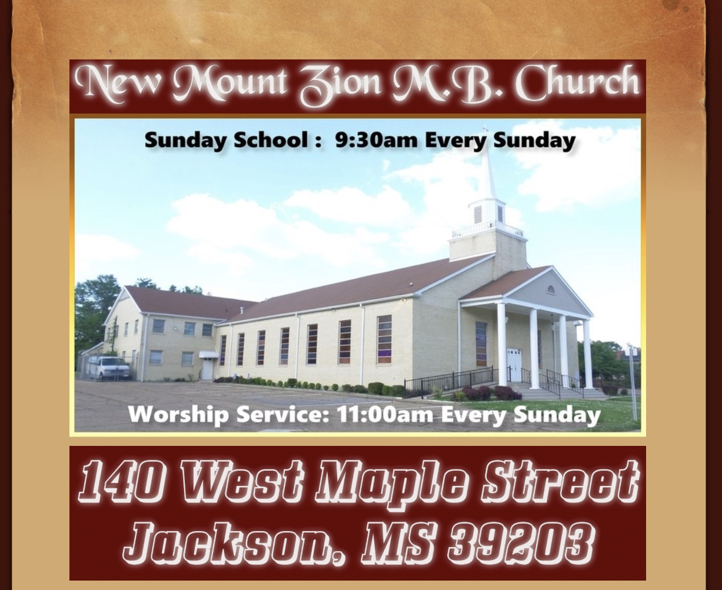
New Mount Zion M.B. Church Bible Class June 22, 2020 “Understanding The Fruit of The Spirit” 2nd Fruit

Slide 2
“But the fruit of the Spirit is love, joy, peace, forbearance, kindness, goodness, faithfulness, gentleness and self-control. Against such things there is no law.” (Galatians 5:22-23) Let’s first understand the difference between joy and happiness. Happiness is an emotion, and God never intended for people to be in that emotional state all the time. There is “a time to weep, and a time to laugh; a time to mourn, and a time to dance” (Ecclesiastes 3:4). Biblical joy—the true joy—comes from filling the spiritual void with good relationships, primarily an intimate relationship with the One who is pure joy.

Slide 3
In Greek, the word for JOY is chara. This noun describes a feeling of inner gladness, delight, or rejoicing. It is a depth of assurance and confidence that ignites a cheerful heart – and in turn, that cheerful heart leads to cheerful behavior. The fruit of the Spirit, as we now know, is what happens when the Holy Spirit dwells in a believer – that is, you or me. To have the Holy Spirit within us is to be “filled with an inexpressible and glorious joy” (1 Peter 1:8). The Scriptures are a testament to the generations of God’s people who have been commanded by the Lord to “rejoice” – even long before Jesus walked the earth.

Slide 4
The Bible speaks much more often of joy than of being happy. “Hap” means chance and is the root of several words— happen, happening, haphazard(dependent on mere chance), hapless, happenstance(a chance circumstance) and happy. Happiness is a glad feeling that depends on something good happening. God wants you to experience happy times (as long as God approves of what is happening). But His greater desire is that you have unconditional joy. John 15:11; John 16:22.

Slide 5
The Gospel begins with the promise of joy (Luke 2:10). This is the first, important lesson about the joy that comes from God: it encompasses all. Where Jesus is concerned, everyone is invited to share in the good news, in the feasting, and the celebrations – from the least to the greatest (Hebrews 8:11; Jeremiah 31:34).

Slide 6
And when Paul lists the “fruit of the Spirit,” joy is second, preceded only by love (Galatians 5:22-23). If we are filled with godly love, shouldn’t that produce joy? Of course it will. Being second in the list surprises many people who mistakenly think joy is spiritually unimportant. Some religious people even shun joy, at least subconsciously, thinking that pious people should instead be solemn. A few even choose asceticism, which God abhors.

Slide 7
Joy is a major topic in the Bible. In the King James Version, “joy” appears 158 times and “rejoice” 198 times (not counting other variations such as joyful, joyfully, joyous, jubilant, happy and glad). Rejoice is the verb form of joy, meaning to feel or have joy! Clearly there is great emphasis in the Bible on feeling and expressing joy. That explains why the Bible also emphasizes prayers and songs that praise (celebrate) God (James 5:13; Colossians 3:16-17).

Slide 8
Joy is largely composed of gratitude—gratitude for the wonderful things God has done for us and His “exceedingly great and precious promises” for our future (2 Peter 1:4). Gratitude produces joy (1 Thessalonians 5:16-18). And our gratitude should be for other people’s blessings as well as for our own (Romans 12:15). Try to follow this biblical formula: Add to your life gratitude, humility, forgiveness, faith, hope, patience and love. Take away resentment, anger, fear, worry, materialism, greed, jealousy, complaining and pride. The result? Joy!

Slide 9
Joy is spiritual, supernatural and essential God is joyful—far more than any human being ever was! It’s tragic that many people think of God as somber and stern rather than cheerful and smiling with a great sense of humor. He is enjoying His creation, and especially the delightful anticipation of many new sons (Romans 8:14; Romans 8:19). True followers (imitators) of God will be joyful also. Psalms 68:3 & Deuteronomy 28:47. Paul spoke of the “joy of the Holy Spirit” (1 Thessalonians 1:6). It is through His Spirit that God shares and communicates His joy.

Slide 10
Joy is not optional. The Bible repeatedly commands us to rejoice! The most emphatic exhortation is in Philippians 4:4, where Paul says, “Rejoice in the Lord always. Again I will say, rejoice!”

Slide 11
Is it wrong to have sorrow? . The Bible describes two kinds of sorrow. “For godly sorrow produces repentance leading to salvation, not to be regretted; but the sorrow of the world produces death” (2 Corinthians 7:10). Those who have joy frequently experience godly sorrow at the same time. It can be the sorrow of repentance toward God. Those who feel the worst about their sins feel the greatest joy about their forgiveness and God’s amazing grace.

Slide 12
Another example is mourning over the suffering of others while having the joy of knowing that God will eventually solve all problems (Matthew 5:4). Worldly sorrow is generally self-pity or a victim mentality. While one indulges in worldly sorrow, it’s virtually impossible to have either godly sorrow or joy.

Slide 13
Joy because of trials? . God’s joy continues to flow through His people even during their suffering because of their rock-solid hope. They know that all suffering is limited to this short life, and the time will soon come when “there shall be no more death, nor sorrow, nor crying” (Revelation 21:4). They “rejoice in hope of the glory of God” (Romans 5:2). .. We also have good reason to rejoice because of our trials when we understand how God is using those trials to help us build godly character. “And we know that all things [even severe trials] work together for good to those who love God, to those who are the called according to His purpose” (Romans 8:28).

Slide 14
More specifically, Paul wrote that “we also rejoice in our sufferings, because we know that suffering produces perseverance; perseverance, character; and character, hope” (Romans 5:3-4, New International Version). James wrote, “Consider it pure joy, my brothers, whenever you face trials of many kinds, because you know that the testing of your faith develops perseverance”—perseverance in remaining faithful to God (James 1:2, NIV). And because Christ suffered for each of us, we should have a special joy when we are persecuted for our faith. Jesus said, “Rejoice and be exceedingly glad, for great is your reward in heaven” (Matthew 5:11-12).

Slide 15
The number one key to joy: . God’s Spirit Supreme joy is God’s nature and character! We see proof everywhere in God’s creation—birds singing, animals leaping, flowers blooming, brooks babbling and the sun shining! Many people would be less depressed if they would spend more time outside. God “gives us richly all things to enjoy” (1 Timothy 6:17). Since God is exceedingly joyful, His servants should also be joyful! Sadly, many who claim to be His disciples are austere, sour and dour. But take note of Luke’s description of true disciples: “And the disciples were filled with joy and with the Holy Spirit” (Acts 13:52).

Slide 16
What then? Our unique joy begins because Christ lives in us (Galatians 2:20). He tells us to “rejoice because your names are written in heaven” (Luke 10:20). We then have an intimate relationship with the One Psalms 43:4 calls “God my exceeding joy.” In His presence “is fullness of joy” (Psalms 16:11). God’s Spirit is a tree of life, producing life-giving fruit (Galatians 5:22-23). That fruit includes great joy. Jesus prayed for His followers “that they may have My joy fulfilled in themselves” (John 17:13). He also teaches us to pray for joy and for all our needs. As He tells us in John 16:24, “Ask, and you will receive, that your joy may be full!”

Slide 17
And here is another lesson about the second fruit of the Spirit: we can find joy in adversity. This can be a difficult concept to grasp, because joy might be the last thing we are feeling when we are facing struggles of our own. But our God knows, sees, and understands everything we are facing. He knows sorrow, heartache, sadness, and grief, and He calls us to rejoice anyway. God tells us that there is a time for every emotion (Ecclesiastes 3:1-8). During His earthly ministry, Jesus exemplified joy. He faced opposition from his enemies, and hey, even disbelief from his friends! He certainly had his fair share of adversity, and yet Jesus’ enemies accused him of being too joyful:

